Slide 1

DOSETWIN AI: A DIGITAL TWIN FRAMEWORK FOR PERSONALIZED DRUG RESPONSE SIMULATION AND MEDICATION CONFLICT PREVENTION
SOA Project Review-1
Thursday, August 20th, 2026
 | Under the Guidance of Dr. Srikanth Cherukuvada Assistant Professor, Department of Computer Science and Engineering, KLH CSE Bowrampet Campus
Team Members P Ruthvik 2420030546 S.Akshay 2420030579 P.Nitish 2420030642

Slide 2
Outline of Research Work
Focus
Introduction
Literature Survey
Challenges
Research Objectives
Conclusion & Future Work
References
Publications Details

Slide 3
Problem Statement
Traditional medication systems often rely on generalized treatment approaches and may not effectively predict how individual patients respond to different drugs. Patients taking multiple medications are also at risk of drug–drug interactions, adverse reactions, and ineffective treatments. Existing systems mainly identify known conflicts but have limited ability to simulate personalized drug responses before treatment.
Therefore, there is a need for an intelligent Digital Twin-based framework that can create a virtual representation of a patient, analyze their medical and medication data, simulate potential drug responses, and identify medication conflicts. DoseTwin AI aims to address this gap by combining Digital Twins, HL7 FHIR, TensorFlow, Knowledge Graphs, and microservices to support safer and more personalized medication decisions.

Slide 4
Objectives
To develop a Digital Twin model for simulating personalized patient drug responses.
To identify and prevent potential drug–drug and medication conflicts.
To analyze patient and medication data using TensorFlow and Knowledge Graphs.
To provide standardized healthcare data exchange using HL7 FHIR.
To build a scalable microservices-based architecture using FastAPI, PostgreSQL, and Docker.
To support safer and more personalized medication decisions.

Slide 5
Literature Survey
Authors | Title of the Paper | Methodology | Inferences | Limitation / Future Work
Saratkar et al. [1] | Digital Twin for Personalized Medicine Development, Frontiers in Digital Health, 2025 | • Digital Twin models for patient-specific healthcare • Integration of AI, ML and patient data | • Digital Twins can support personalized treatment and predictive healthcare. • Enables patient-specific simulation and treatment planning. | • Data privacy and interoperability remain challenges .• Requires further clinical validation before routine adoption.
Ludwig et al. [2] | Digital Patient Twins for Personalized Therapeutics and Pharmaceutical Manufacturing, Frontiers in Digital Health, 2023 | • Digital patient twins using patient and population data • AI and data-driven modeling for personalized therapeutics | • Digital patient twins can support personalized drug treatment. • Highlights the potential for predicting individual drug responses. | • Reliable individual drug-response simulations are still limited. • Regulatory, scalability and implementation challenges remain.
Woillard et al. [3] | Digital Pharmacological Twins: Bridging Multi-Scale Modelling and Artificial Intelligence for Precision Medicine, Therapie, 2026 | • Multi-scale pharmacological modelling • AI/ML with pharmacokinetic and pharmacodynamic data | • Digital pharmacological twins can simulate drug interactions and individual treatment responses. • Supports precision dosing and reduction of adverse drug reactions. | • Requires strong data integration and model validation. • Interoperability and clinical implementation need further research.

Slide 6
Research Gap Identification
Existing Research / Approach | Research Gap Identified | Our Proposed Solution
1. Digital Patient Twins for Personalized Healthcare – Existing research uses Digital Twins to represent patients by integrating medical, physiological, and health data for personalized healthcare and treatment planning. | Current Digital Twin research is still developing, and reliable patient-specific drug-response simulation is not yet fully achievable. Many approaches remain conceptual or limited to specific diseases or physiological conditions. (PubMed) | DoseTwin AI Digital Twin – Creates a patient-specific virtual model that combines patient medical data, medication history, and AI-based drug-response prediction to simulate possible treatment outcomes before medication is administered.
2. AI-Based Drug Response and Interaction Prediction – Machine Learning and pharmacological models are increasingly used to predict drug effects, adverse reactions, and drug–drug interactions. | Existing approaches often focus on individual prediction tasks and do not provide a unified patient model that continuously combines medication information, patient characteristics, and interaction relationships. Reliable individualized drug-response prediction remains a major challenge. (ScienceDirect) | AI Drug Response & Conflict Engine – Uses TensorFlow + Knowledge Graphs to analyze patient-specific factors, medicines, and relationships between drugs, identifying potential conflicts and predicting likely responses.
3. FHIR-Based and Knowledge-Graph Healthcare Systems – Recent systems use HL7 FHIR, Knowledge Graphs, and AI to improve healthcare interoperability and patient-centric data management. | Although these technologies improve data integration, there is still a need for a scalable system that connects standardized patient data directly with Digital Twin simulation and medication safety analysis. Interoperability, data integration, validation, privacy, and scalability remain challenges. (ScienceDirect) | FHIR-Enabled Microservices Architecture – DoseTwin AI integrates HL7 FHIR + Knowledge Graph + TensorFlow through FastAPI microservices, with PostgreSQL for structured data and Docker for scalable deployment, enabling personalized drug simulation and medication conflict prevention.

Slide 7
Novelty
Novelty 1 : Personalized Drug-Response Digital Twin
Creates a virtual representation of an individual patient to simulate and predict drug responses based on patient-specific medical and medication data.
Novelty 2 : AI + Knowledge Graph for Medication Conflict Prevention
Combines TensorFlow and Knowledge Graphs to identify relationships between patients, drugs, diseases, and medications, enabling early detection of potential drug–drug conflicts.
Novelty 3 : FHIR-Enabled Microservices Architecture
Integrates HL7 FHIR with FastAPI microservices, PostgreSQL, and Docker to provide standardized, scalable, and interoperable healthcare data processing for personalized medication safety.

Slide 8
Tech Stack
Layer | Technology Stack
Core Framework | Digital Twin
Healthcare Data & Interoperability | HL7 FHIR
AI & Machine Learning | TensorFlow
Knowledge Representation | Knowledge Graphs
Backend / Microservices | FastAPI
Database | PostgreSQL
DevOps / Deployment | Docker

Slide 9
Innovation, Creativity, and Novelty
Innovation:
Uses a Digital Twin of the patient to simulate personalized drug responses before treatment.
Creativity:
Combines TensorFlow and Knowledge Graphs to analyze patient–drug relationships and detect potential medication conflicts.
Novelty:
Integrates Digital Twin, HL7 FHIR, AI, and Knowledge Graphs into a microservices-based framework for personalized drug-response simulation and medication safety.

Slide 10
Feasibility
Technical Feasibility:
The project can be implemented using Digital Twins, HL7 FHIR, TensorFlow, Knowledge Graphs, FastAPI, PostgreSQL, and Docker, which are suitable for building the proposed system.
Operational Feasibility:
DoseTwin AI can provide a simple workflow for patient data management, drug-response simulation, and medication conflict detection, making it practical for healthcare-related use.
Economic Feasibility:
The project can be developed using open-source technologies and frameworks, reducing development and deployment costs.
Scalability:
The microservices architecture and Docker enable individual services to be developed, deployed, and scaled independently.

Slide 11
Project Plan
Phase | Activity | Output
Phase 1 | Literature Survey & Requirement Analysis | Problem definition and system requirements
Phase 2 | Digital Twin & System Architecture Design | Digital Twin and microservices architecture
Phase 3 | Healthcare Data & FHIR Integration | HL7 FHIR-based patient and medication data
Phase 4 | AI & Knowledge Graph Development | Drug-response prediction and medication conflict analysis
Phase 5 | FastAPI & PostgreSQL Integration | Connected services and structured data management
Phase 6 | Docker Integration, Testing & Validation | Integrated and validated working system
Phase 7 | Documentation & Final Demonstration | Project report and working prototype

Slide 12
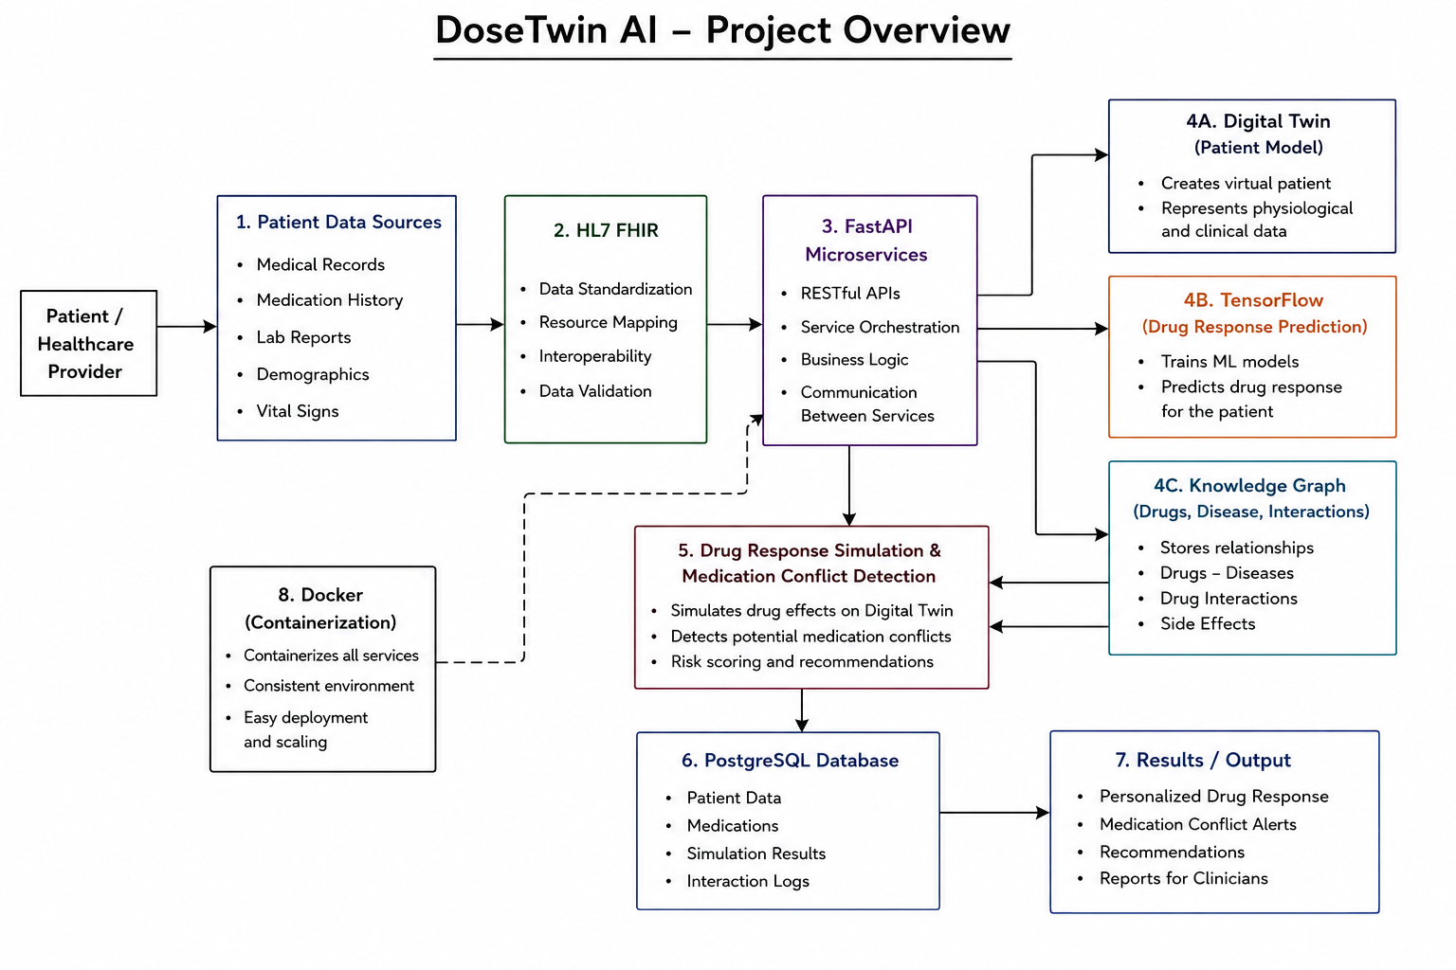
Project Architecture/Project Overview:

